Slide 1


REINFORCEMENT LEARNING-BASED TRADING STRATEGY
Presented by
Ally Saha Antarlin Chanda Gulivindala Naveen Kumar Harendra Sai Nath Lella Shramana Bhattacharya
Tamosa Sur
Guided by
Prof. Jaydip Sen

Slide 2
Introduction Objective Basic Concepts Working Principle Important Terms Explaining the terminologies Methodology Results Challenges Conclusion Future Work and Scope
Agenda

Slide 3
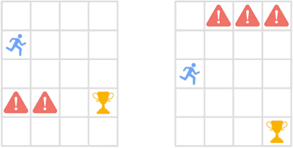
Introduction
The goal of stock market trading is to maximize return with minimum risk.
In Reinforcement Learning, the RL agents can learn the optimal strategies for stock trading.
RL agents can be trained to outperform the buy and sell strategies of humans.

Slide 4
Objective
Main objective of the project is to build an RL agent that trades in stock markets without any human intervention.
S&P 500, NIFTY50, Adani Enterprises Ltd., and Reliance Industries Ltd. have been tested to evaluate the performance of RL agent.

Slide 5
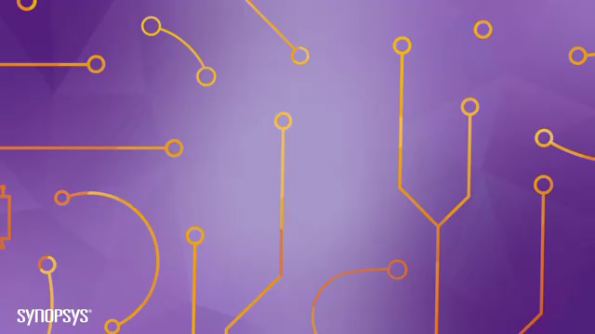
Basic Concepts
What is Reinforcement Learning?
Why Reinforcement Learning?
Source: https://www.synopsys.com/ai/what-is-reinforcement-learning.html
Notes:
Reinforcement learning is an approach towards training a machine to find the best course of action through optimal policies that maximize rewards and minimize risks.
WHY Reinforcement Learning?
Trained over a long time horizon
Have sufficient memory
Potentially good profits

Slide 6
Working Principles
Agent : closing price data is fed
Mini- batch samples with state information (state, action, reward, next state) fed to DQN
Best action gets outputted
Buy / sell / hold decision is taken by Agent to maximize rewards for next state
Notes:
We feed the Agent with the closing price data.
Mini Batch Samples of state information which consists of state, action, reward, and next state are fed into the DQN Network.
Based on those inputs, the neural network outputs the best action(on basis of expected future rewards) corresponding to that state.
Then based on the decision, the agent buys or sells stocks or holds onto it in case not much scope of rewards.
The agent tries to buy, sell stock in such a way that the overall rewards are maximised for next state
The above mechanism is applied on all the data points in the batch, and we get the state, action, reward and the next state data.

Slide 7
Important Terms
Environment
Agent
State
RL components
Action
Reward
Policy
Q value
Model
Notes:
In our Trading Strategy, the RL components are as following
Agent: A Portfolio Manager or a Robo-advisor Built to make trading decisions
Action: Buy, hold, sell
State: Agent’s observation from the environment for taking a decision
Reward function- Realised Profit and Loss
Environment- Stock Exchange

Slide 8
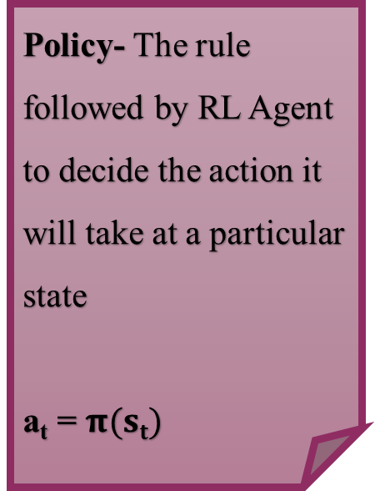
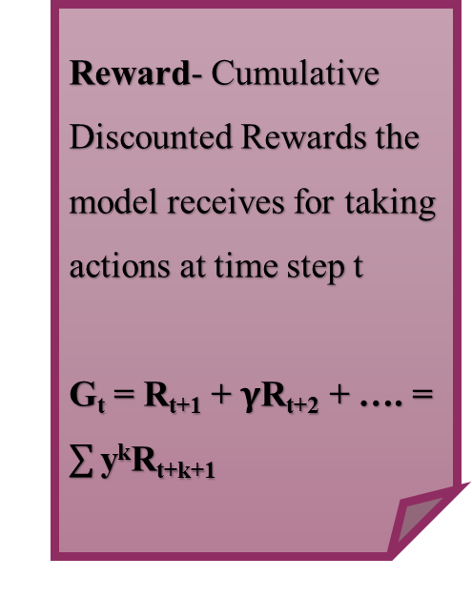
Explaining the Terminologies
Policy- The rule followed by RL Agent to decide the action it will take at a particular state
a_{t} = $π(st)$
Reward- Cumulative Discounted Rewards the model receives for taking actions at time step t
G_{t} = R_{t+1} + $γ$R_{t+2} + …. = $\sum{\text{y}\text{k}\text{R}\text{t}\text{+}\text{k}\text{+1}}$
Value Function(or state Value) - Measures attractiveness of a state through prediction of future reward G
V(s) = E[G_{t}|S_{t}=s]
Action-Value Function (Q-value) of a state-action pair (s, a) - Expected Reward given a state and action
Q(s, a) = E[G_{t}|S_{t} = s, A_{t} = a]
Notes:
Policy- The rule followed by RL Agent to decide the action it will take at a particular state
at = $π(st)$
Reward- Cumulative Discounted Rewards the model receives for taking actions at time step t
Gt = Rt+1 + $γ$Rt+2 + …. = $\sum{\text{ykRt}\text{+}\text{k}\text{+1}}$
Value Function(or state Value)- Measures attractiveness of a state through prediction of future reward G
V(s) = E[Gt|St=s]
Action-Value Function (Q-value) of a state-action pair (s, a)-Expected Reward given a state and action
Q(s, a) = E[Gt|St = s, At = a]
Value Function and Q value interaction- The product of probability distribution of action, state pair and the q value associated with that state and action summed over all pairs gives us back the value function. V(s) = $\sum_{a∈A}{\text{Q}\text{(}\text{s}\text{,}\text{a}\text{)}π\text{(}\text{a}\text{|}\text{s}\text{)}}$
The relationship between reward function (R), future rewards (G), value function, and Q-value is used to derive the Bellman equations

Slide 9
Model Framework
Policy Development
Parameter Optimization
Back testing
Notes:
Requires full summary
Macro system

Slide 10
RL Modelling Framework Terminologies
Bellman equation
Markov Decision Process
Temporal Differences
Deep Q-Network

Slide 11
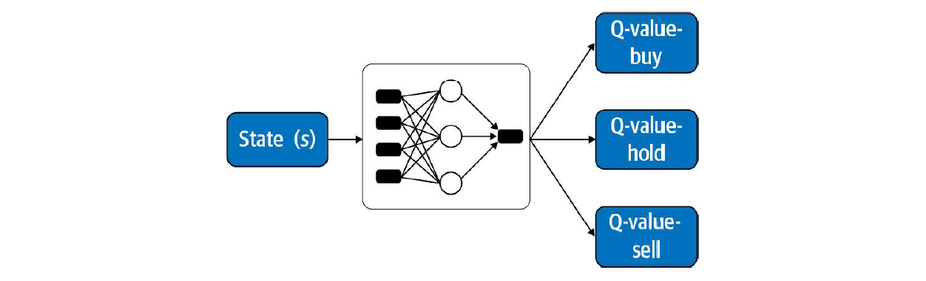
RL Modelling Framework Terminologies
Bellman Equations:
A set of equations that decompose the value function and Q-value into the immediate reward plus the discounted future values.
V(s) = E[R_{t+1} + $γ$V(s_{t+1})|S_{t} = s]
q*(s,a) = E[R_{t+1} + $γ$maxa’q*(s’,a’)]
Bellman Equations:
A set of equations that decompose the value function and Q-value into the immediate reward plus the discounted future values.
V(s) = E[R_{t+1} + 𝛾V(s_{t+1})|S_{t} = s]
q*(s,a) = E[R_{t+1} + 𝛾maxa’q*(s’,a’)]
Temporal Difference Learning:
The key idea in TD learning is to update the value function V(S,) toward an estimated return (known as the TD target).
V(s_{t}) ← V(s_{t}) + $α$(R_{t+1} + $γ$V(s_{t+1}) – V(s_{t}))
Similarly, for Q-value estimation:
Q(s_{t}, a_{t}) ← Q(s_{t}, a_{t}) + $α$(R_{t+1} + $γQ$(s_{t+1}, a_{t+1}) – Q(s_{t}, a_{t}))
Temporal Difference Learning:
The key idea in TD learning is to update the value function V(S,) toward an estimated return (known as the TD target).
V(s_{t}) ← V(s_{t}) + 𝜶(R_{t+1} + 𝜸V(s_{t+1}) – V(s_{t}))
Similarly, for Q-value estimation:
Q(s_{t}, a_{t}) ← Q(s_{t}, a_{t}) + 𝜶(R_{t+1} + 𝜸𝐐(s_{t+1}, a_{t+1}) – Q(s_{t}, a_{t}))
Q-learning & DQN:
The Q learning algorithm evaluates which action to take based on a Q-value function.
Through the use of a Deep Neural Network, we will try to find the optimum weights for which the rewards are maximized. ANN and DNN learn to map states to values or state action pairs to Q values.
Markov Decision Process:
Markov Decision Process describes an environment for reinforcement learning.
Notes:
Bellman Equations:
A set of equations that decompose the value function and Q-value into the immediate reward plus the discounted future values.
V(s) = E[R_{t+1} + $γ$V(s_{t+1})|S_{t} = s]
q*(s,a) = E[R_{t+1} + $γ$maxa’q*(s’,a’)]
It is used to find optimal q∗ in order to find optimal policy π and thus a reinforcement learning algorithm can find the action a that maximizes q∗(s, a). That is why this equation has its importance.
MDP:
Markov Decision Process describe an environment for reinforcement learning.
Trading in the market can be formalized as an MDP, which is a process that has specified transition probabilities from state to state
Temporal Difference Learning
In real life transition probabilities between states are not known.
In general, we assume that the agent initially knows only the possible states and actions and nothing more. For example, the agent uses an exploration policy, a purely random policy, to explore the MDP, and as it progresses, the TD learning algorithm updates the estimates of the state values based on the transitions and rewards that are actually observed.
The key idea in TD learning is to update the value function V(S,) toward an estimated return (known as the TD target).
V(st) ← V(st) + $α$(Rt+1 + $γ$V(st+1) – V(st))
Similarly, for Q-value estimation:
Q(st, at) ← Q(st, at) + $α$(Rt+1 + $γQ$(st+1, at+1) – Q(st, at))
ANN and deep learning:
Through the use of a Deep Neural Network, we will try to find the optimum weights for which the rewards are maximized. ANN and DNN learn to map states to values or state action pairs to Q values.
Q-learning and Deep Q learning:
The Q learning algorithm evaluates which action to take based on a Q-value (or action-value) function
For each state-action pair (s, a), this algorithm keeps track of a running average of the rewards, R, which the agent gets upon leaving the state s with action a, plus the rewards it expects to earn later. Since the target policy would act optimally, we take the maximum of the Q-value estimates for the next state
In cases where the state and action space are large, the optimal Q-value table quickly becomes computationally infeasible.
Q-learning may suffer from instability and divergence.
How to overcome the Q learning drawbacks?
We use ANN parameter ‘$θ$’ to solve this problem.
The deep Q-learning algorithm approximates the Q-values by learning a set of weights, θ, of a multilayered deep Q-network that maps states to actions.
Why DQN and not QN?

Slide 12
Deep Q – Network (DQN) Mechanism
Experience Replay
Neural network is trained based on observed experience
improves data efficiency, removes correlations in the observation sequences
Periodically Updated Target- This modification makes the training more stable as it over- comes the short-term oscillations.
Loss Function
The loss function is as follows:
L($θi$) = E[(r + $γ$maxQ(s’, a’; $θ$_{i-1}) – Q(s, a; $θ$_{i}))²]
The loss function is as follows:
L(𝜽_{𝐢}) = E[(r + 𝜸maxQ(s’, a’; 𝜽_{i-1}) – Q(s, a; 𝜽_{i}))²]
To learn the network parameters, the algorithm applies gradient descent
A loss function defined as the squared difference between the DQN's estimate of the target and its estimate of the Q- value of the current state-action pair, Q(s,a:θ).
Notes:
The algorithm aims to greatly improve and stabilize the training procedure of Q-learning through two innovative mechanisms:
Experience Replay
Periodically Updated Target
Experience Replay- Experience replay improves data efficiency, removes correlations in the observation sequences, and smooths over changes in the data distribution.
Periodically Updated Target- This modification makes the training more stable as it over- comes the short-term oscillations.
To learn the network parameters, the algorithm applies gradient descent’ to a loss function defined as the squared difference between the DQN's estimate of the target and its estimate of the Q- value of the current state-action pair, Q(s,a:θ). The loss function is as follows:
L($θi$) = E[(r + $γ$maxQ(s’, a’; $θ$i-1) – Q(s, a; $θ$i))2

Slide 13
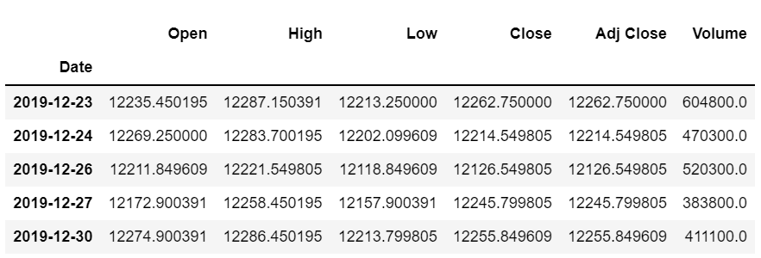
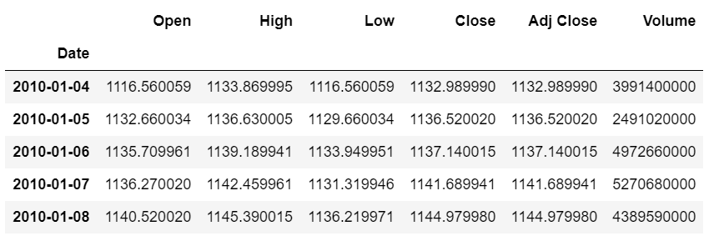
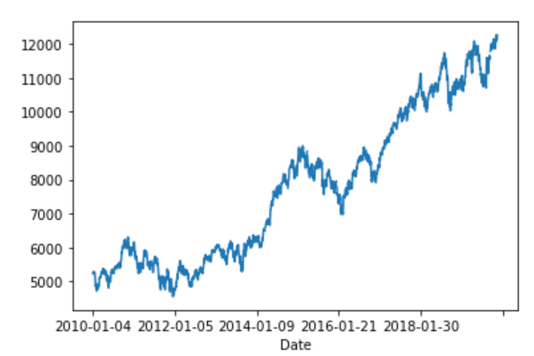
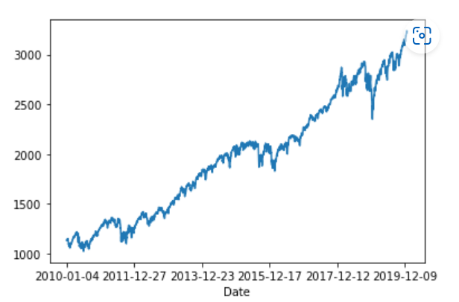
Dataset (NIFTY50 & S&P500)
NIFTY50
S&P500

Slide 14
Methodology
We have used Yahoo Finance Historical Stock Price data: S&P500, NIFTY50, Adani Enterprises Ltd., and Reliance Industries Ltd.; years: 2010-2019
Import Required Libraries
Load the Dataset
Exploratory Data Analysis
Data Preparation & cleaning
Testing
Training
Helper functions
Building Agent class
Train - Test split

Slide 15
Steps…1
Data Cleaning & train-test split
Null values are replaced by previous values
Building an Agent class
The constructor defines important parameters like state_size, action_size, memory, gamma, epsilon, epsilon_min, epsilon_decay.
We have done a train-test split
Defining the model and act functions
ExpReplay Function
Model function: We define the Deep Neural Network architecture here which will be used to estimate the Q values.
This function stores a history of the state, action, reward, and next-state transitions that are experienced by the agent.
Defines components: constructor, function, model, function act, function expReplay
Act function: Returns an action given a state.
Notes:
We are using a skeletal code. But we have learnt it and tried to execute it.
State size: how many days to bring in to compute state – that is 2.
Sigmoid function to normalize to squash
Agent: trading agent, actions: buy,sell,hold ; reward function: realized PnL, state: size is 2, environment: stock exchange
Model function:ANN model maps states to actions. takes In a state of environment and returns a Q value table that refers to the probability distribution over actions. Built using Keras python library.
Three hidden layers: 64,32 and 8 nodes, ReLu activation func is used. Output layer has number of nodes equal to 3, linear activation function.
ExpReplay: Experience replay mechanism. It takes a mini batch of observations (replay memory) as an input and updates the deep learning based Q learning model weights by minimizing the loss function. Target variable for Q table is updated based on Bellman equation. Updation takes place at the end of the episode/ round.
Predict the Q values of next state using deep learning model.
Model.fit function is used to update the weights by minimizing the loss function.
Epsilon greedy approach is implemented: It selects an action randomly with a probability of epsilon or the best action according to Q value function with prob 1-epsilon.
It takes mini-batch of ovservations (replay memory) as an input and updates the deep learning-based Q-learning model weights by minimizing the loss function.
Prepare the replay buffer memory, which is the set of observation used for training. New experiences are added to the replay buffer memory using a for loop.
Loop across all the observations of state, action, reward, and next state transitions in the mini-batch.
3. The target variable for the Q-table is updated based on the Bellman equation. The update happens if the current state is the terminal state or the end of the episode. This is represented by the variable done and is defined further in the training function. If it is not done, the target is just set to reward.
4. Predict the Q-value of the next state using a deep learning model.
5. The Q-value of this state for the action in the current replay buffer is set to the target.
6. The deep learning model weights are updated by using the modet.fit function.
7. The epsilon greedy approach is implemented. Recall that this approach selects an action randomly with a probability of e or the best action, according to the Q- value function, with probability l - e.

Slide 16
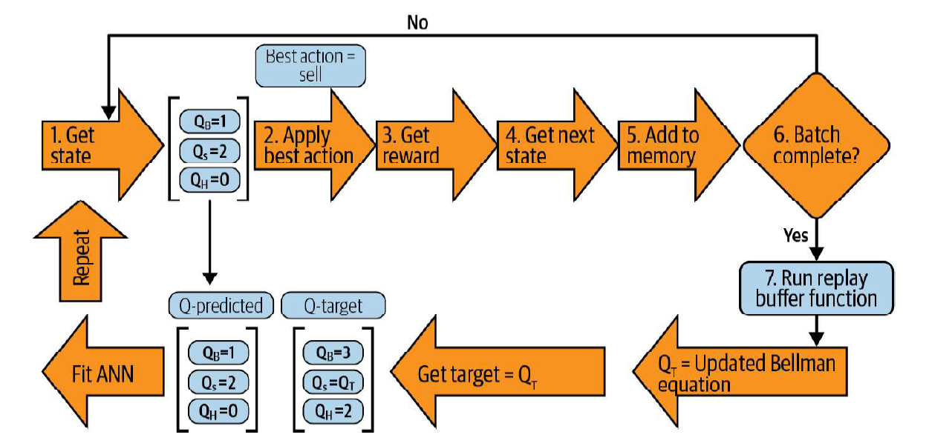
Steps…2
Helper Functions
We create additional helper function which aid our training like the function getState.
Model Training
In this step, we perform the training of the data using agent and helper methods.
Plot_behavior: The function prints the corresponding graphs in training and testing.
Model Training
Notes:
We are using a skeletal code. But we have learnt it and tried to execute it.
State size: how many days to bring in to compute state – that is 2.
Sigmoid function to normalize to squash
Get_state
The function getstate generates the states given the stock data, time t (the day of prediction), and window n (number of days to go back in time). First, the vector of price difference is computed, followed by scaling this vector from zero to one with a sigmoid function.
Episode: Number of times the code is trained through the entire data.
Window size: number of market days to consider to evaluate the state
Batch size: size of the replay buffer or memory use during training.
We train the model iterating through the episodes.
Upper section, steps 1 to 7, refers to the steps in the training module and lower section describes the steps in the replay buffer function (exeReplay function)
Get the current state using getState. It returns a vector of states which are between 0 and 1
Get the action for the given state using act function of agent class.
Get the reward for the given action. Initialized as zero.
Get the next state using getState. Used to uodate Q value function.
Details of the reward, action, state, next state are saved to memory of the agent class which is used further by expReplay function.
If batch size is complete, we move to Replay buffer function and update the Q function by minimizing MSE between Q predicted and Q target. Ow. Move to next state.
It takes mini-batch of ovservations (replay memory) as an input and updates the deep learning-based Q-learning model weights by minimizing the loss function.
Prepare the replay buffer memory, which is the set of observation used for training. New experiences are added to the replay buffer memory using a for loop.
Loop across all the observations of state, action, reward, and next state transitions in the mini-batch.
3. The target variable for the Q-table is updated based on the Bellman equation. The update happens if the current state is the terminal state or the end of the episode. This is represented by the variable done and is defined further in the training function. If it is not done, the target is just set to reward.
4. Predict the Q-value of the next state using a deep learning model.
5. The Q-value of this state for the action in the current replay buffer is set to the target.
6. The deep learning model weights are updated by using the modet.fit function.
7. The epsilon greedy approach is implemented. Recall that this approach selects an action randomly with a probability of e or the best action, according to the Q- value function, with probability l - e.
Plot_behavior
The function plot_behavior returns the plot of the market price along with indica- tors for the buy and sell actions. It is used for the overall evaluation of the algorithm during the training and testing phase.
Similar to other machine learning techniques, we can find the best combination of model hyperparameters in RL by using techniques such as grid search.
The grid search for RL-based problems are computationally intensive.
Epsilon - It is the basic starting point where. I would like to initiate the exploration.
Epsilon Decay- Controls exploration-exploitation trade-off. High decay rates will cause RL to go into exploitation too early which is bad. The lower rate will make the model to take random actions for too long and would not try to exploit past knowledge before episode ends.
Epsilon Minimum- It is the minimum exploration rate. No matter how much we have learned, there should still be scope to learn something new. This parameter ensures that even in later part of an episode some exploration will be going on.
Episode_Count - The number of times the model is trained through the entire data. Higher episode count better but with the caveat of increased computational complexities. Here, we have run the model with an episode count of 10.
Batch Size - Size of replay buffer or memory used during training. Here, the batch_size is 32.
Window Size - Large Window Sizes causes too much low pattern detection while low window size will cause the model to be focused on immediate time stamps rather than generalization. We gave the window size as 1.
Gamma – It is the discount factor for future rewards. Higher Value Indicates more certainty to get rewards and vice versa. In our model, we used gamma value as 0.95
Neural Network No. of layers and nodes in layers - These decide the no of latent features and the complexity that I would be able to detect and make use of them. Higher value is preferred, but propounds computational complexity challenges.

Slide 17
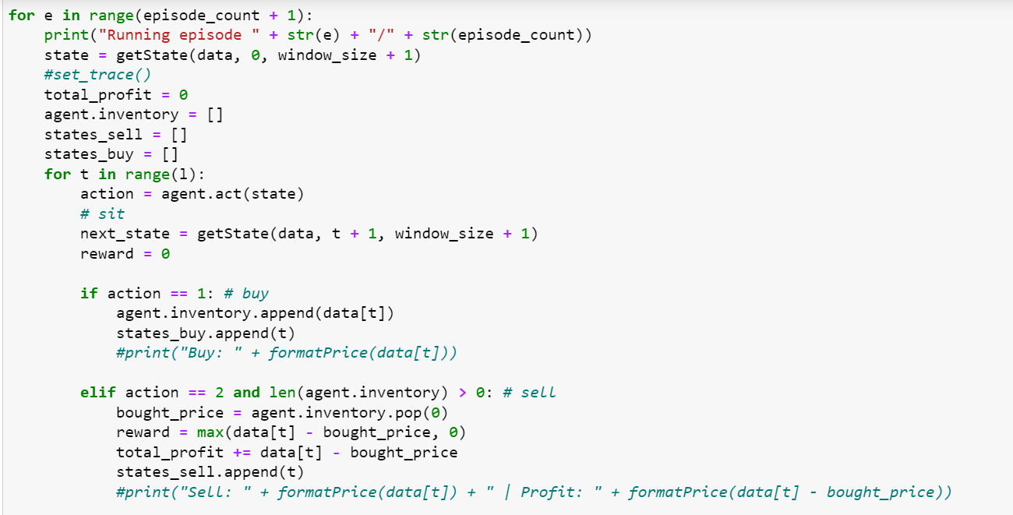
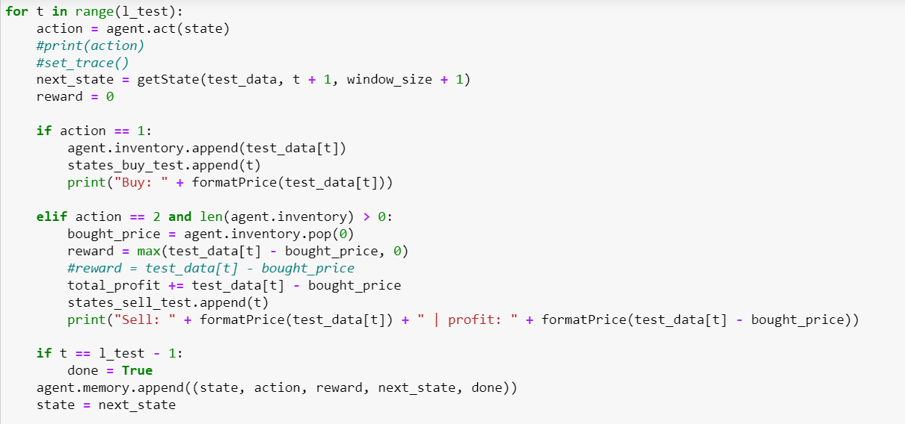
Model Training & Testing Codes
Training Code
Testing Code

Slide 18
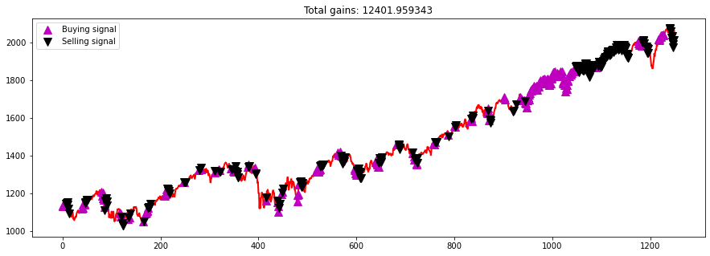
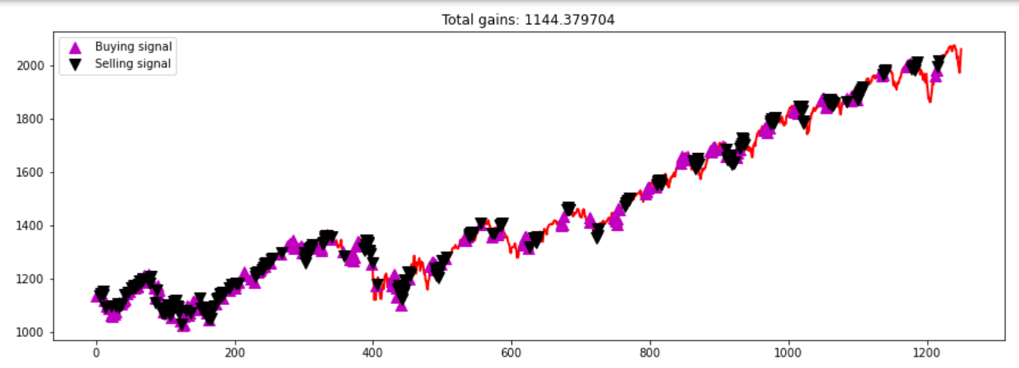
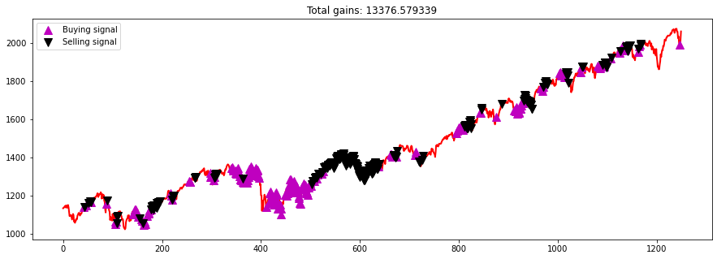
Results: Training Episode output(s) of S&P500 dataset
Episode 1
Episode 2
Episode 10
Notes:
Ideally, the number of training episodes should be higher than the number used in this case study. A higher number of training episodes will lead to a better training performance.
In the beginning, the agent takes randomized actions to observe the rewards associated with it, since there is no preconception of the consequences of its actions.
The cumulative reward fluctuates substantially in the beginning illustrates the exploration process the algorithm is going through.
In later episodes, the agent begins to learn from training and discovers strategy to exploit it consistently. The PnL for the last episodes are far more robust and the overall profit is stable.
A higher number of training episodes will lead to a better training performance.

Slide 19
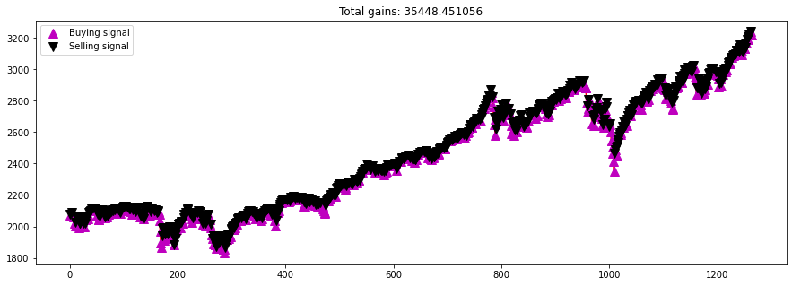
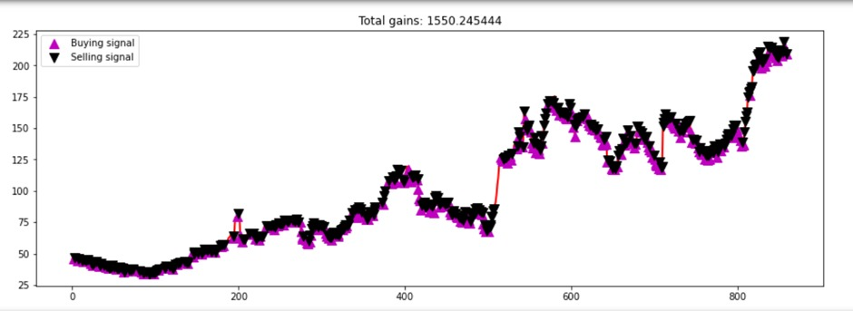
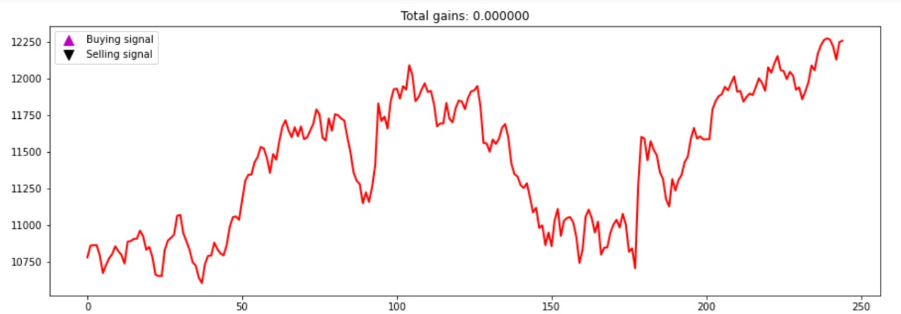
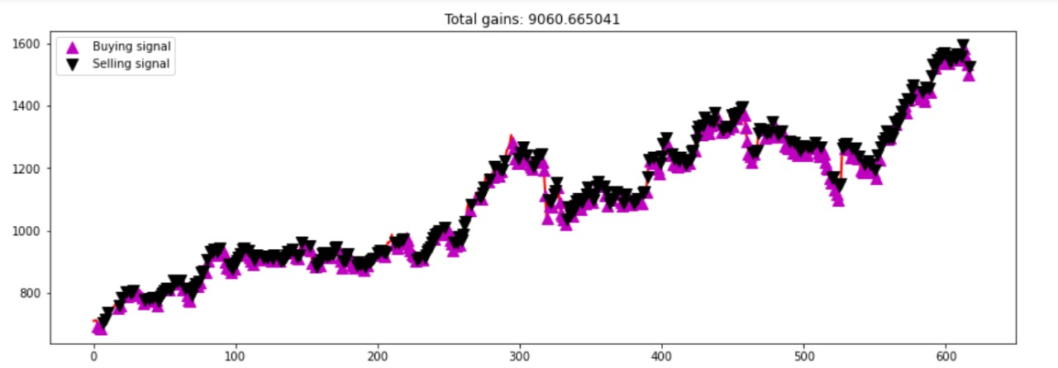
Results: Test output
S&P500
Adani Enterprises Ltd.
NIFTY50
Reliance Industries Ltd.

Slide 20
Challenges
Reinforcement Learning is extremely computationally intensive.
Most of our systems were not able to run the program in a reasonable time period.
Even Colab Pro+ crashed after running for some time due to a high episode count to the point that RAM usage crossed 60 GB+.
With the help of our own PC, we were able to run the program up to an episode count of 30, with the help of virtual RAM of 60GB+, in addition to the original RAM of 16GB

Slide 21
Execution Platform Descriptions
PC – Asus Rog Strix G15 AMD Advantage Edition
AMD RYZEN 9 5900HX-Octacore Overclocked to 3.3 GHZ-4.6 GHZ
GPU-AMD RX6800M 12GB VRAM
RAM-16GB DDR4
VirtualRAM-60GB

Slide 22
Special observation
Question: Why the agent is holding on in some occasions?
In many programs runs it was found that the RL agent was not taking any action whatsoever in the testing dataset.
This can be because of the fact that the amount of reward it was expecting was less than desired.
Agent wanted to hold the stocks to some higher future values when prices are much higher or lower to sell or buy respectively.
The RL agent was not able to learn much from the environment.
Notes:
The RL agent was not able to learn much from the environment i.e., its was not able to extract much pattern out of the data in such a short span of episodes and for the other hyperparameters used and is unsure of what to do and according to the Q values that we got, the best course of action was to hold out only.

Slide 23

Conclusion
In this project, we have designed an RL agent using Q and DQ learning and deployed it with several real-world index series and stock price series.
The framework has been fine-tuned, optimized, and trained, and its performance is evaluated on the hold-out test dataset.
While, there were occasional hiccups, overall, the performance of the agent looked quite satisfactory.
Notes:
Future Directions of work
In this project, we have designed an RL agent using Q and DQ learning and deployed it with the real world SP500, Nifty50 ..several real world index series and stock price series.
The framework has been fine tuned, optimized and trained, and its performance is evaluated on hold-out test dataset.
While, there were occasional hiccups, overall, the performance of the agent looked quite satisfactory.
Conclusion and future work: Future work includes further optimizing and fine tuning the current RL framework and exploring other approaches of RL like policy based systems. We may plan for a future publication also.

Slide 24
Future works and scope
Future work includes further optimizing and fine-tuning the current RL framework
Another direction of work will certainly be looking for other variants of the RL framework like policy gradient-based models and a comparative analysis of those models with the current one will be an interesting case.
Notes:
Further variants of RL models will also be investigated.
Another direction of work will certainly be looking for other variants of RL framework like policy gradient based models and comparative analysis of those models with the current one will be an interesting case.

Slide 25

Thank You

Slide 26

Questions?

